Slide 1

SAN FRANCISCO CRIME DATA
Julie Maria Petersen

Slide 2
DATA SCIENCE PIPELINE PIPELINE
COLLECTION
Integration of different sources
PREPARATION
Cleaning, missing values, anomalies, outliers and transformations
EXPLORATION
Patterns and trends across different dimensions
MODELLING
Machine learning algorithms
VALIDATION
Evaluation of performance
DEPLOYMENT
MLOps and maintenance
1
2
3
4
5
6

Slide 3
DATA SCIENCE PIPELINE PIPELINE
COLLECTION
Integration of different sources
PREPARATION
Cleaning, missing values, anomalies, outliers and transformations
EXPLORATION
Patterns and trends across different dimensions
MODELLING
Machine learning algorithms
VALIDATION
Evaluation of performance
DEPLOYMENT
MLOps and maintenance
1
2
3
4
5
6

Slide 4
2 Preparation

Slide 5
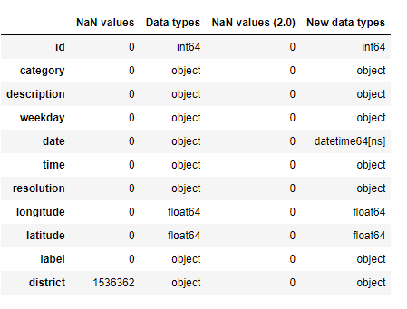
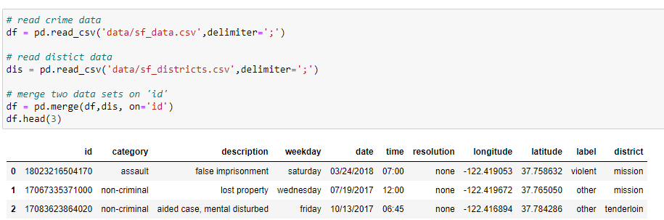
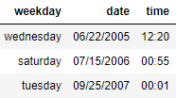
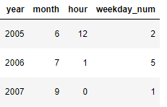
Overview and cleaning
Check for and replace missing values
Transform time variables
2
3
Rows: 2129216
Columns: 11
Time range: 2003/01/01 -2018/05/15
4
5
Import and merge data
Add time variables
5

Slide 6
3 EXPLORATION
Trends across time and space

Slide 7
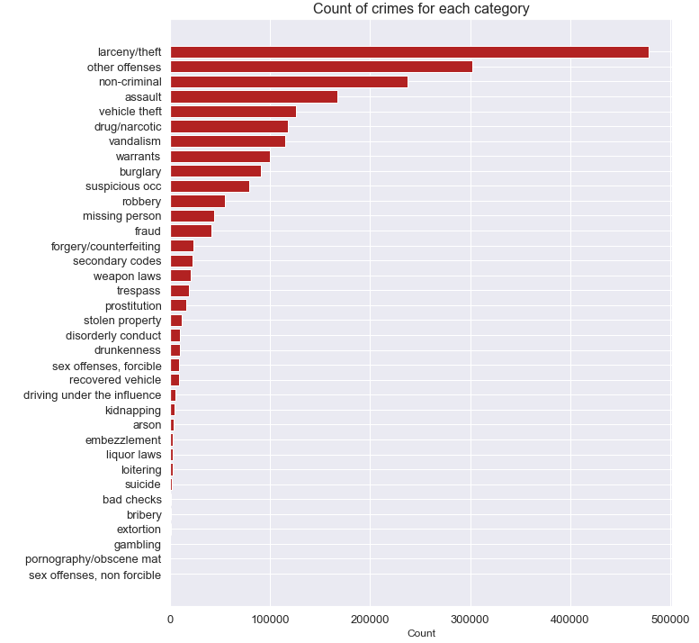
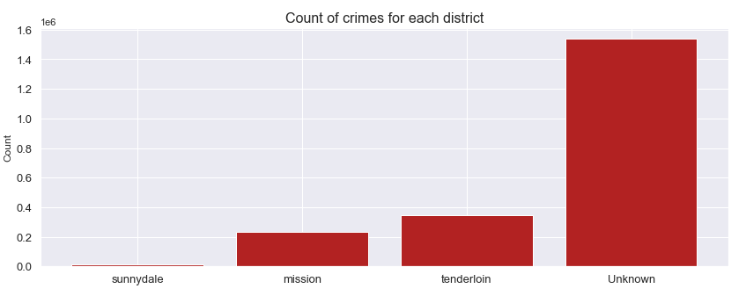
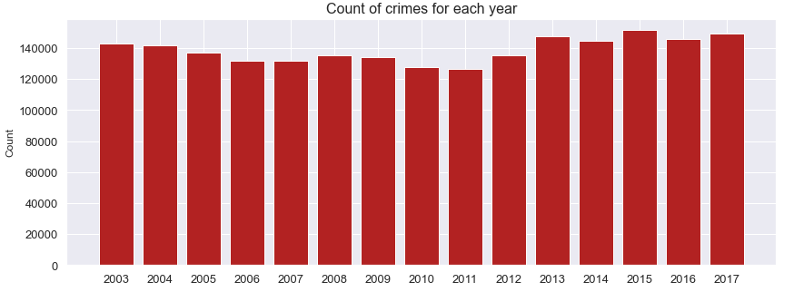
Overall distribution of crimes
2
3
4
5
7

Slide 8
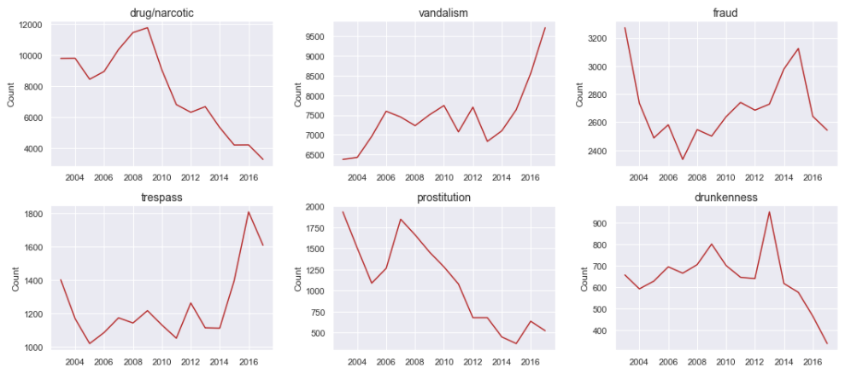
Yearly patterns
2
3
4
5
8

Slide 9
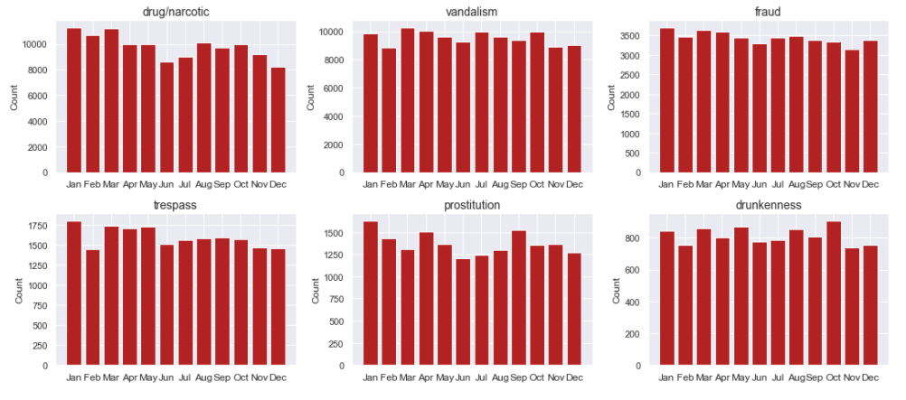
Monthly patterns
2
3
4
5
9

Slide 10
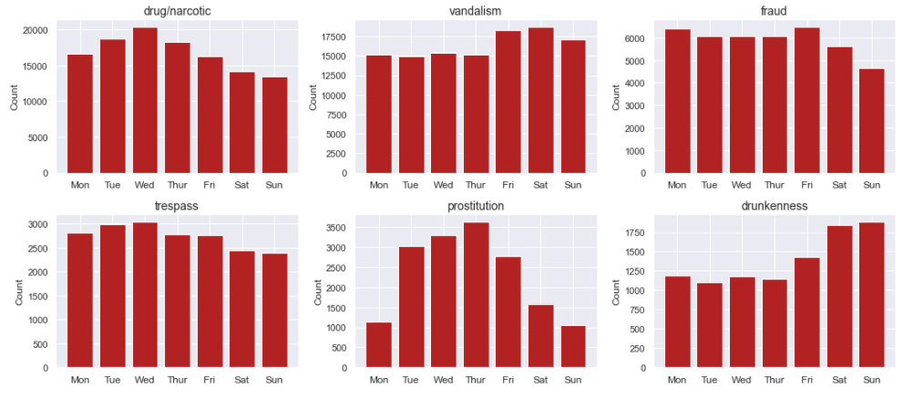
Weekly patterns
2
3
4
5
10

Slide 11
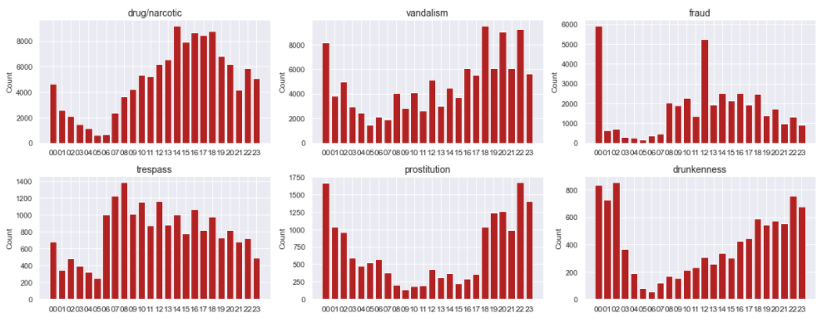
Hourly patterns
2
3
4
5
11

Slide 12
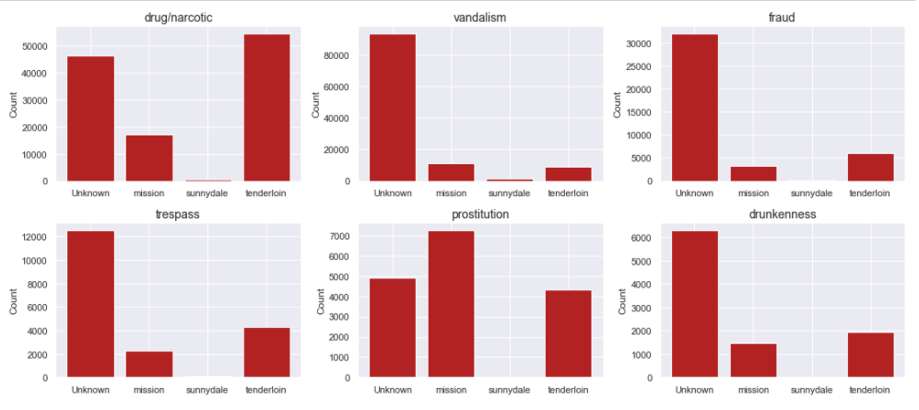
Crimes across districts
2
3
4
5
Year 2017
12

Slide 13
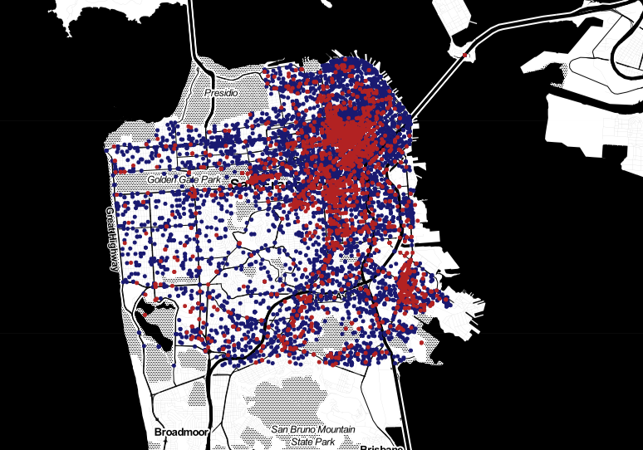
Mapping of some crimes
2
3
vandalism
4
drug/narcotic
5
Year 2015
13

Slide 14
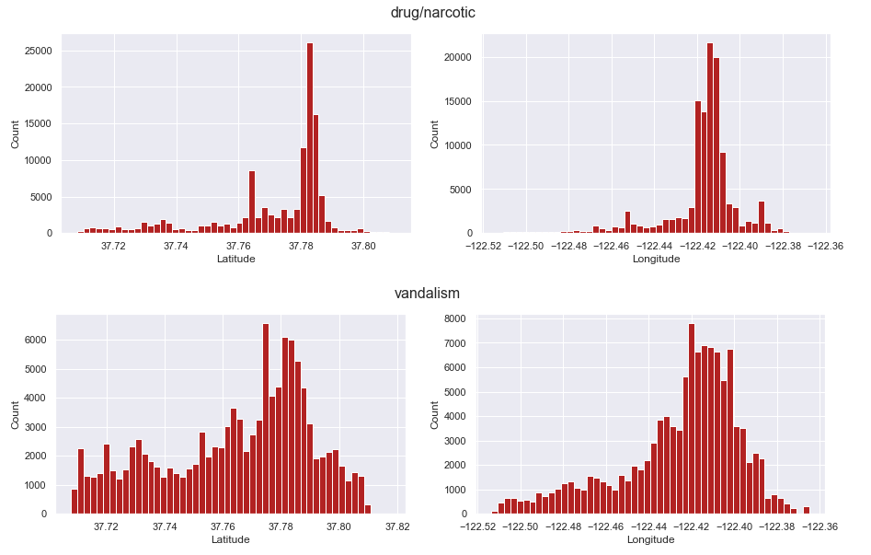
Spread of coordinates
2
3
4
5
Year 2015
14

Slide 15
4 MODELLING
Crime category classification

Slide 16
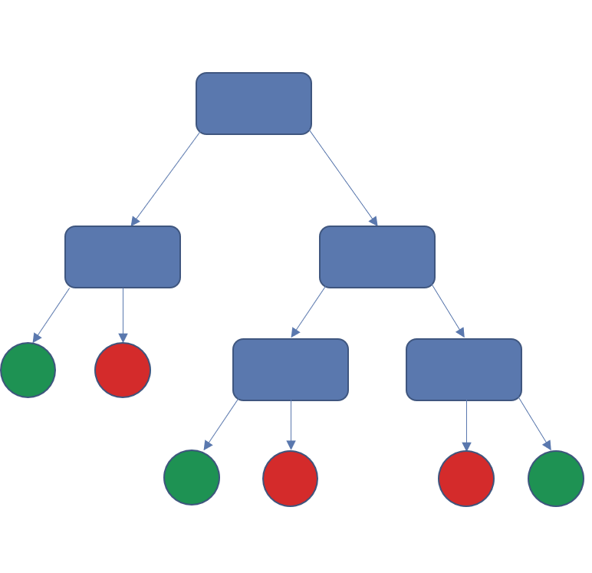


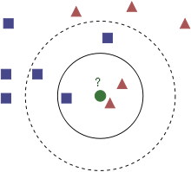
Predict type of crime based on location and time
2
Features
Classes
3
4
5
District
Longitude
Random Forest (RF)
Latitude
VANDALISM
114705
?
DRUG/NARCOTICS
117810
Month
Weekday
K-nearest neighbors (KNN)
Hour of day
16

Slide 17
5 EVALUATION
Performance scores

Slide 18
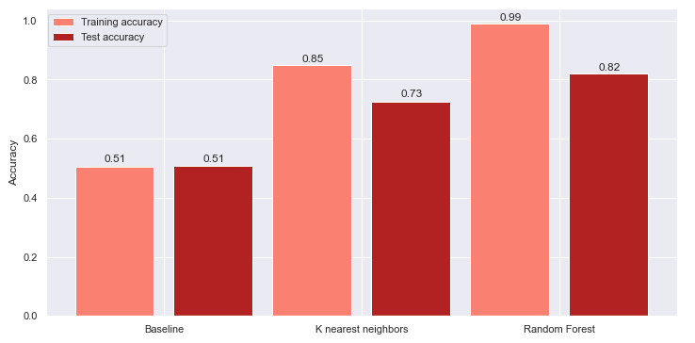
Performance of models
2
3
4
5
2/12/2022
18

Slide 19
Potential next steps
2
3
Map coordinates to more districts to avoid ‘unknown’
Improve model performance by e.g
Cross validation
Hyperparameter tuning
Adding more features (e.g. weather data, demographics)
Removing features
Try other algorithms
4
5

Slide 20

THANK YOU

